Slide 1
Heart Disease Prediction:
Nutritional Labels for An Automated Decision System in Healthcare
Team Members:
Ray Chen (yjc464)
Nancy Wen (nw1334)
Notes:
Hi I’m Nancy and this is Ray and the ADS system we are reviewing today is a heart disease prediction tool that is trained on a heart disease dataset from Kaggle.

Slide 2
Table of contents
1
2
3
4
5
6
Background
Input and output
Implementation
Purpose of the heart disease ADS
Data input features and output of the system
Data cleaning and pre-processing
Validation
Outcomes
Summary
ADS validation
Effectiveness and Performance of ADS
Observations and Suggestions
Notes:
We will be go through the purpose of this ADS system, describe the data that the system is trained on, how the model is implemented and evaluated. We will go into detail about the performance of the ADS system in terms of accuracy and fairness, and finally we will conclude with suggestions on how to improve the system.

Slide 3
Background
We propose to build a nutritional label for an ADS system that predicts heart disease using a healthcare dataset from Kaggle.
We believe that it is important to provide a nutritional label for healthcare ADS systems in order to prevent bias and increase trust in the system.
source : https://www.kaggle.com/nareshbhat/eda-classification-ensemble-92-accuracy/notebook#Model-Evaluation
Notes:
We chose this ADS system because we think automated systems are being more frequently used in healthcare, and it is important to provide a nutritional label for these systems because they have such direct impact on patient care and treatment.

Slide 4
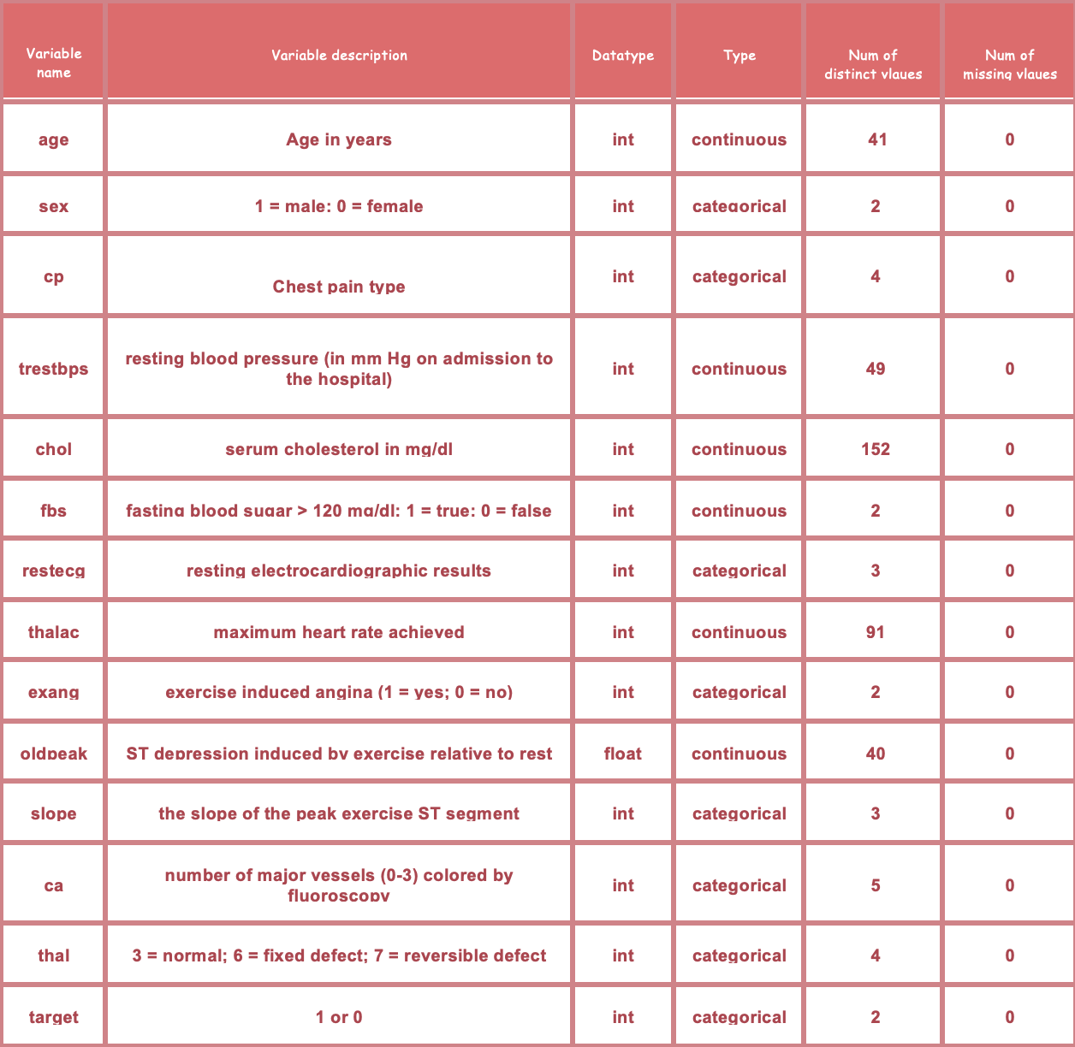
Input of data
source : https://archive.ics.uci.edu/ml/datasets/Heart+Disease
Notes:
Let’s look first at the data that the model is trained on. It is from Kaggle and it is derived from a larger heart disease dataset with 76 attributes but this dataset only contains the most commonly used 14 features. None of the features have any missing values, and they are all integers but some are categorical and some are continuous. The data contains 303 rows.

Slide 5
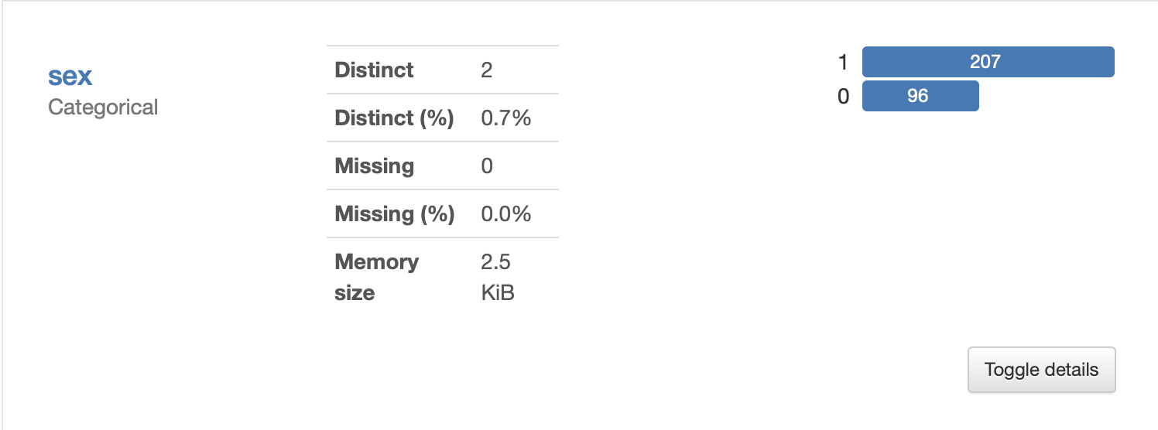
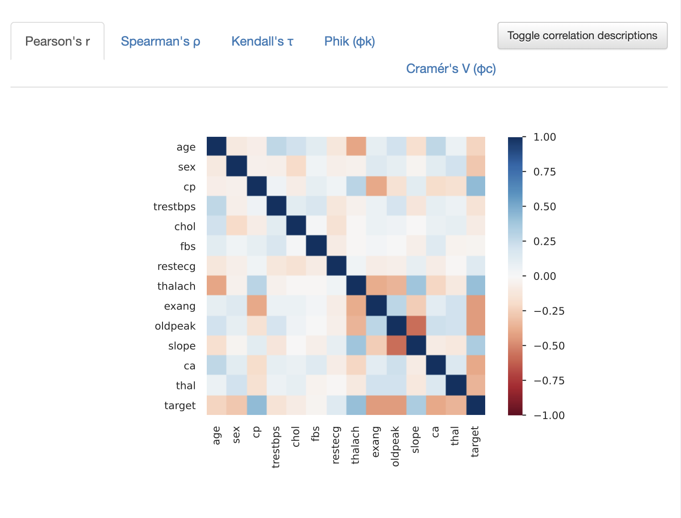
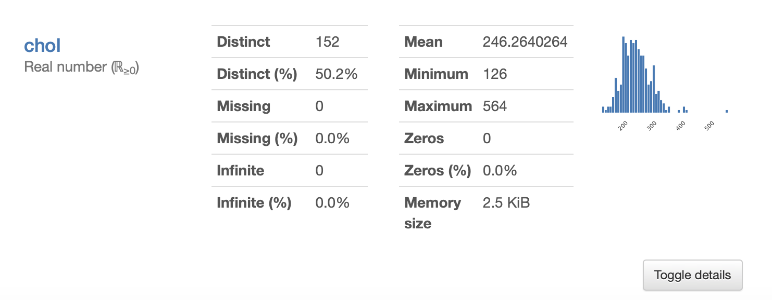
Output of Data
Observation:
The values for the ‘sex’ feature is imbalanced: fewer women then men in the dataset (96 versus 207).
Positive correlation between chest pain (cp) and target (our predictor).
Negative correlation between exercise induced angina (exang) and our predictor.
source : https://www.kaggle.com/nareshbhat/health-care-data-set-on-heart-attack-possibility
Notes:
We did exploratory data analysis and noticed that there is a significant gender imbalance. Less than ⅓ of the 303 data points is female, and the rest are male.
We also looked at the correlation matrix between all of the features and the target, and some fo the features stood out to us. For example, cp (which is type of chest pain) and exercise induced angina are both highly correlated with the target.

Slide 6
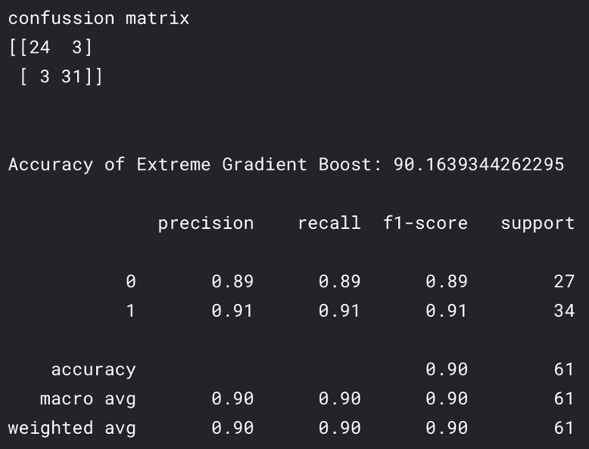
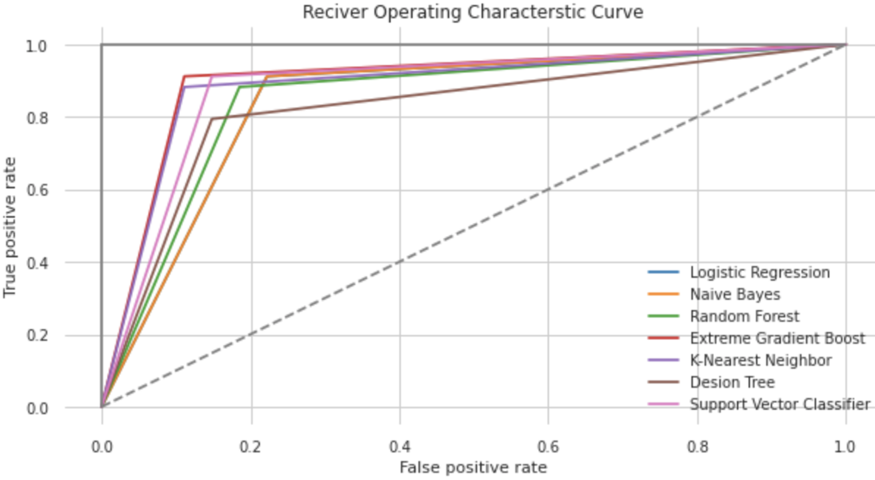
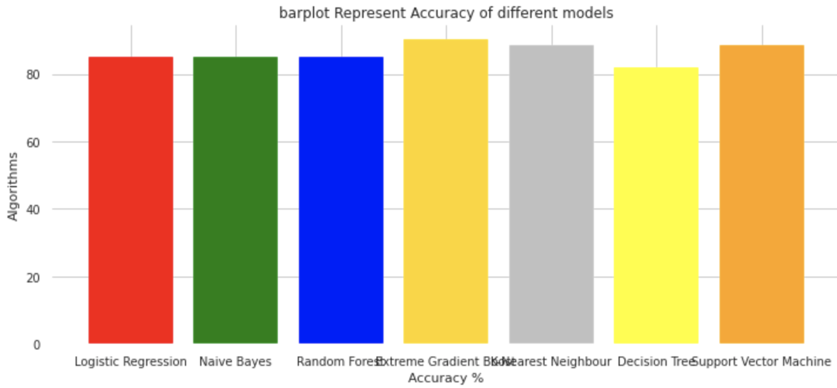
Implementation and Validation
Model Preparation
Modeling / Training
Model Evaluation
Model Output
It’s a gas giant and the biggest planet in the Solar System
80%
20%
Train Set
Test Set
E.g. Extreme Gradient Boost model
E.g. ROC curve of all of the models
E.g. Accuracy of different models
source : https://www.kaggle.com/nareshbhat/health-care-data-set-on-heart-attack-possibility
Notes:
We reviewed the implementation of the ADS system. The creator of system evaluated several different types of models and then combined the top three performing models (XGBoost, SVM, KNN) into a stacked ensemble model. His final model has a test accuracy of 90%.

Slide 7
Fairness Measures: evaluate different subpopulations (divided by sex)
Female
Male
Accuracy on female subpopulation is 88.2%
Accuracy on male subpopulation is 90.9%.
11 (TP)
0 (FN)
20 (TP)
3 (FN)
confussion
matrix
confussion
matrix
2 (FP)
4 (TN)
1 (FP)
20 (TN)
Observation:
The difference in accuracy between the genders is 2.7%.
The False positive rate (FPR) for male patients is much lower than the FPR for female patients (4.7% versus 33.3% respectively).
The False negative rate (FNR) for male patients is higher than the FNR for female patients (13% versus 0% respectively).
source : RDS Lab 1: ProPublica's Analysis of the COMPAS Tool, RDS Lab 4 & 5: Predict early readmission for diabetes patients based on their laboratory and medications record
Notes:
We did a deeper dive into the accuracy, and saw that the female accuracy was 2% lower than the male accuracy. We also saw differences in the FPR and FNR.

Slide 8


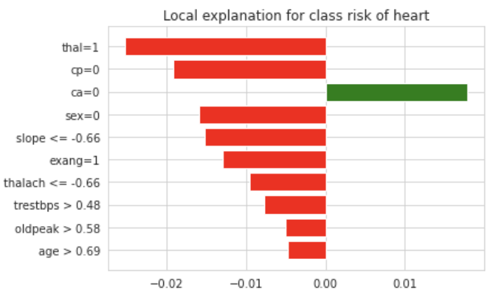
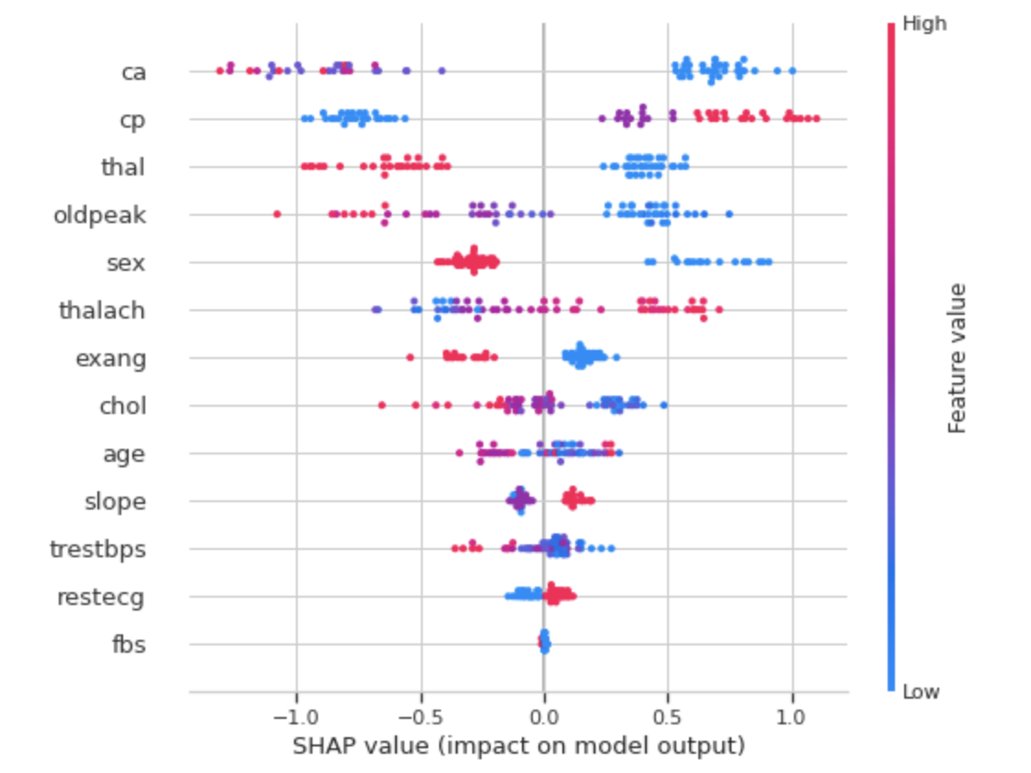
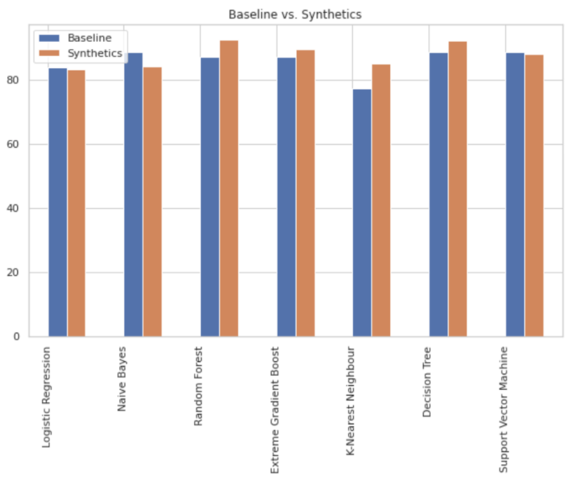
Interpretability
LIME
SHAP
Synthetic Data
Result: Share some of the top features comparing with XGboost feature importance, but sometimes the prediction is completely opposite.
Result: Summary plot is explainable and replaces the typical bar chart of feature importance.
Result: The synthetic data model shows improvements in 4 out of 6 classification.
source : RDS Lab 1: ProPublica's Analysis of the COMPAS Tool, RDS Lab 4 & 5: Predict early readmission for diabetes patients based on their laboratory and medications record
Notes:
We further use LIME and SHAP to see that the dataset contains features with strong predictive power for predicting heart disease. And also, we collect more training examples for female to deal with the imbalanced dataset causes accuracy to be lower for females. We use synthetic data to augment the number of female samples and the new models shows improvements in 4 out of 6 classification.

Slide 9
Summary
1
2
3
Fairness is crucial because the ADS should be equally accurate for both men and women.
The ADS tool should only be used by medical professions in conjunction with in-person health checkups.
Collect more data from female patients. Deal with imbalanced dataset issue using synthetic data to reduce algorithmic biases.

Slide 10

Thank you !

